Slide 1
VQA-AG model selection

Slide 2
GPN model(Generator-Pretester Network)
Video encoder
Joint Question-Answer generator
Answer selector
Question generator
GPN model component
Pretester
Input: video and question controller(question type)
Output: question-answer pair

Slide 3
Model input and output
CNN extracted visual features(dim R^{n*2048})
Model input features
object features(dim R^{n*256})
Question controller
Question Q={Q_1,…,Q_m}
Model output
Answer

Slide 4
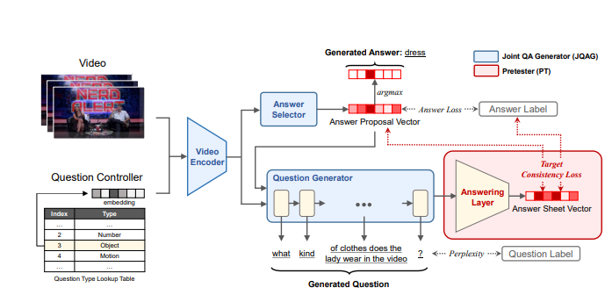
Model Structure

Slide 5




Joint Question-Answer Generator(JQAG)
Video Encoder
Intention: generate a question-answer pair
Step 1: fuse frame feature and object feature with a projection W_proj
Step 2: Utilize Question Controller C to incorporate question type
Step 3: Feed V^src into self attention layers, and initialize first layer by positional encoding of V^src
Step 4: mean-pool the last layer output to obtain the clip level representation, and receive video embedding for answer and question generation

Slide 6

Joint Question-Answer Generator(JQAG)
2) Answer selector
Intention: produce answer proposal vector according to the video
Take video embedding and feed forward by two trainable linear layers, and receive answer proposal vector.
It represents the distribution of answer likelihood for each candidate answer.
A is picked by picking the one with the highest likelihood.
Training stage: A is optimized by cross entropy loss

Slide 7



Joint Question-Answer Generator(JQAG)
3) Question Generator
Intention: output the question based on video embedding and answer proposal vector
With LSTM decoder(2 hidden layers and an output layer), generate the question word-by-word
Qi: i-th word, Hi: i-th hidden state,
Initialization of hidden state:
Loss of question generator:
Ultimately, the last Q is the generated question.

Slide 8





Pretester(PT)
Intention: It pretests the generated question and generates an Answer Sheet Vector , then it optimizes the consistency between answer sheet vector , answer proposal , and the ground truth answer
Step 1: Answering layer acts as an agent to answer the question and generates the Answer Sheet Vector
Step 2: Compute Target Consistency Loss(TCL) according to the following
(1) CE between Answer Sheet Vector and ground truth
(2) KL divergence between Answer sheet vector and Answer proposal vector
And TCL is computed via
Final loss is the sum of TCL

